Slide 1
ANALYSING NEW YORK APARTMENTS SALES DATASET AND CLUSTERING THE CITIES USING KMEANS CLUSTERING

Slide 2
INTRODUCTION
In this project we will help people who are all looking to buy an apartment in the New York City.
They can choose to live in residential or commercial areas and can see which borough is best
which BOROUGH has the highest sales and which has the lowest sales
Which BOROUGH has the highest sale price for the apartment and which is having the lowest sale price for the apartment
One can able to find the advantages and disadvantages of the Neighborhoods by exploring the dataset.
One can able to find the appropriate price for the square feet in different cities and boroughs.
By using kmeans clustering and the Four Squared location data set we can cluster the cities in the Borough.

Slide 3
DATA ACQUISITION AND CLEANING
DATA ACQUISITION:
The dataset used in this project has been acquired from kaggle dataset
This dataset is a record of every building or apartment sold in a New York city property market in 2017 over a period of 12 months.

Slide 4
DATA ACQUISITION AND CLEANING
DATASET:
This contains the location, address, type, sales price and sale date of building units sold
BOROUGH: A digit code for the borough the property is located in; in order these are Manhattan (1), Bronx (2), Brooklyn (3), Queens (4), and Staten Island (5).
BLOCK; LOT: The combination of borough, block, and lot forms a unique key for property in New York City. Commonly called a BBL.
BUILDING CLASS AT PRESENT and BUILDING CLASS AT TIME OF SALE: The type of building at various points in time. See the glossary linked to below.

Slide 5
DATASET USED FOR CLUSTERING NEIGHBORHOOD
NEW YORK CITY NEIGHBOURHOODS DATASET
This city has total of 5 boroughs and 306 Neighborhoods. In order to segment the Neighborhoods and explore them, we will essentially need a dataset that contains the 5 boroughs and the Neighborhoods that exists in each borough as well as the latitude and longitude coordinates of each Neighborhood

Slide 6
DATA CLEANING
The dataset consists of 84548 rows and 22 columns
The first step is to check for those attributes which are helpful for our data analysis
Here we are considering only 8 columns out of the 22 columns and the 8 columns are as follows:
Zip code
Borough
Neighborhood
Building Category
Residential Unit
Building Class
Land Square Feet
Sales Price

Slide 7
DATA CLEANING
Since the column names have spaces in it for our convenient, we are renaming our column names.
They are as follows
ZIP CODE- ZIP_CODE
LAND SQUARE FEET – SIZE
SALE PRICE – PRICE
BUILDING CLASS CATEGORY - BUILDING_CATEGORY
RESIDENTIAL UNITS - RESIDENTIAL_UNITS
BUILDING CLASS AT A TIME OF SALES – BUILDING CLASS

Slide 8
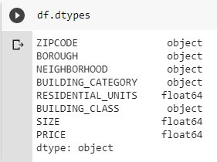
DATA CLEANING
Now we are checking for the types of the attributes using the command dtypes
We have to change all the attributes to the respective data types by using the command .astype()

Slide 9
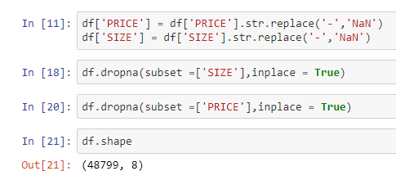
DATA CLEANING
Since we are having zero values in the price column as well as the size column, we have to replace it with NaN and remove those NaN values using the command .dropna
By using the shape command, we are checking the length, now it has been reduced to 48799

Slide 10
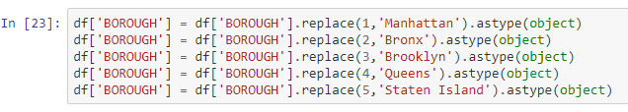
The borough has the values 1,2,3,4 and 5 representing each borough. We have to change it into their respective borough names i.e. Manhattan, Bronx, Brooklyn, Queens, Staten Island respectively

Slide 11
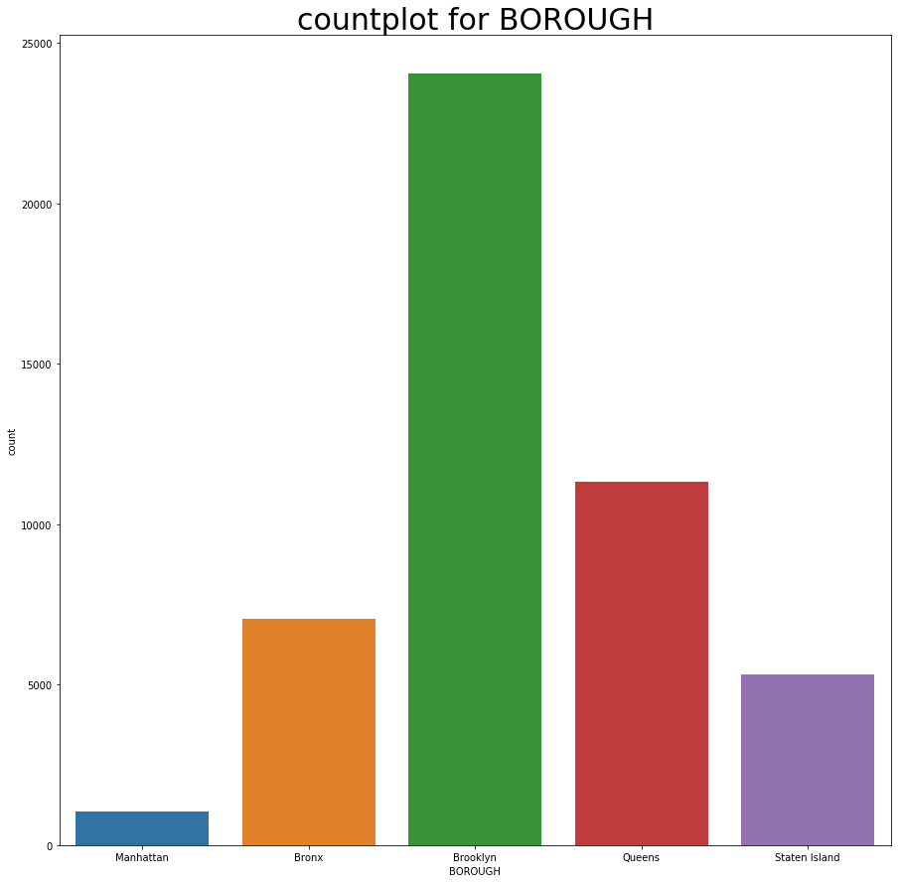
From this graph, we can see that the borough has 5 cities in which Brooklyn has the highest sales

Slide 12
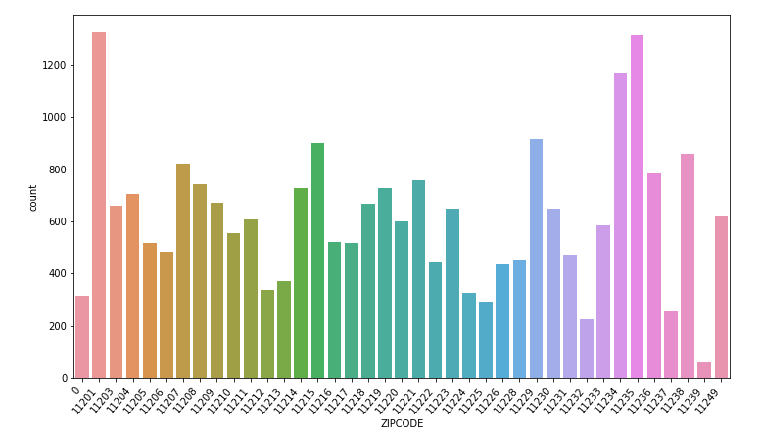
COUNT PLOT FOR ZIP CODE OF BROOKLYN
From this graph, we can see that the zip code 11201 has the highest sales and the count is 1324

Slide 13
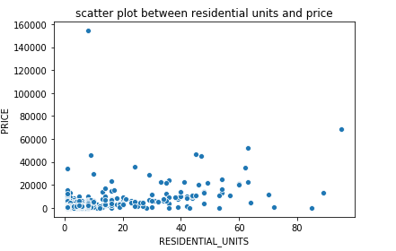
SCATTER PLOT BETWEEN RESIDENTIAL UNITS AND PRICE
This scatter plot is between residential units and price and it has an outliers

Slide 14
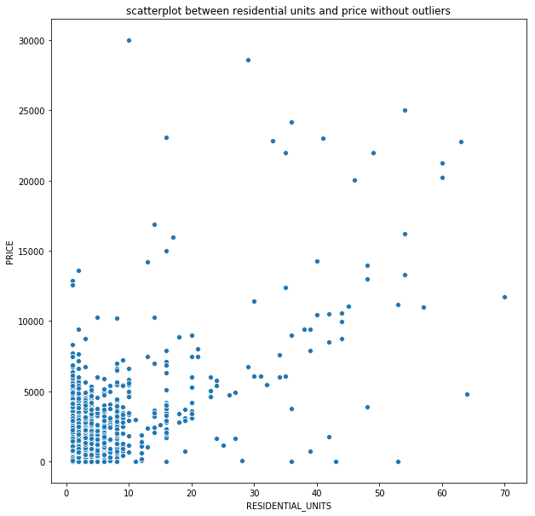
SCATTER PLOT BETWEEN RESIDENTIAL UNITS AND PRICE WITHOUT OULIERS
In order to remove the outliers, the price range has been set up from 0 to 30000 and the residential units has been allocated from 0 to 70

Slide 15
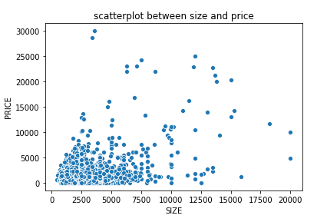
SCATTER PLOT BETWEEN SIZE AND PRICE
This scatter plot is between size and price

Slide 16
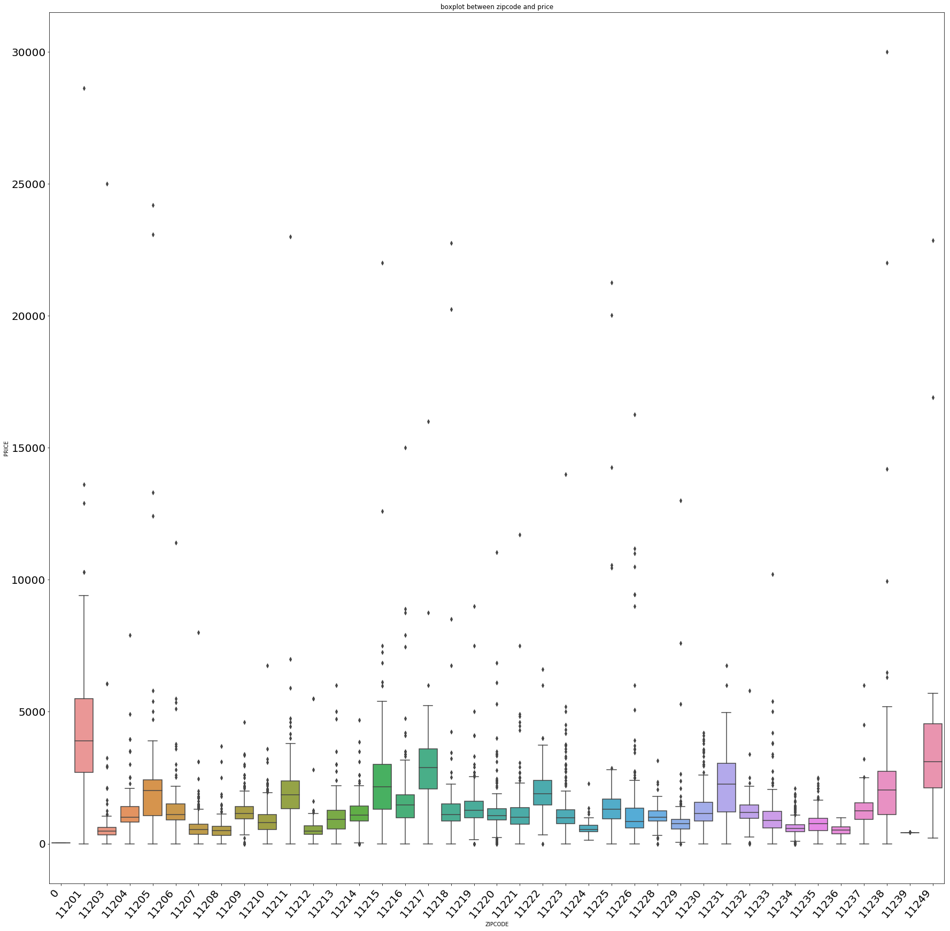
BOXPLOT FOR ZIPCODE AND PRICE
From this , we infer that the postal code 11201 has the highest price range of 3000 with a maximum limit of 9000

Slide 17
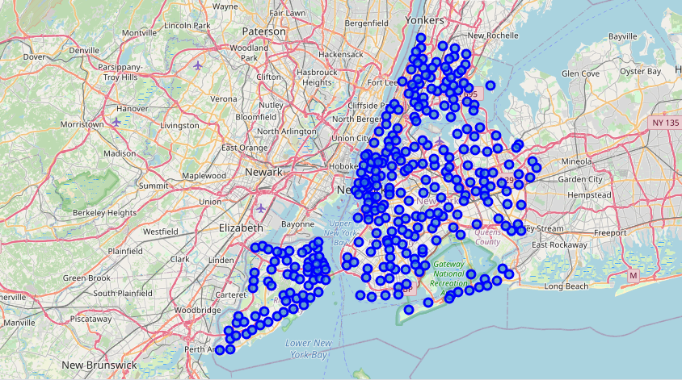
VISUALIZATION OF CITIES IN ALL BOROUGHS OF THE NEW YORK CITY

Slide 18
CLUSTERING
NEW YORK CITY NEIGHBOURHOODS DATASET
This city has total of 5 boroughs and 306 Neighborhoods. In order to segment the Neighborhoods and explore them, we will essentially need a dataset that contains the 5 boroughs and the Neighborhoods that exists in each borough as well as the latitude and longitude coordinates of each Neighborhood
From this dataset, we extracted the Brooklyn Borough data alone and save it as a separate data frame
Each city in the Brooklyn borough has a separate latitude and longitude, with the help of these data we will be able to extract the venues location data from FOURSQUARED API

Slide 19
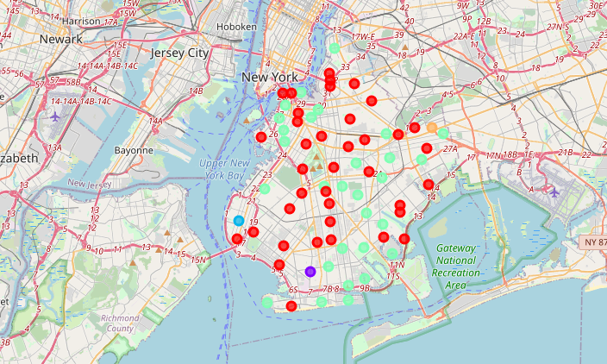
CLUSTERING
From this, venue category data can be obtained
These venues category data is used for the clustering purpose with the help of KMEANS clustering
VISUALIZATION OF EACH CLUSTER IN BROOKLYN BOROUGH

Slide 20
RESULTS
From the New York Apartment sales dataset
Sales in Brooklyn Borough is high when compared to all other Boroughs in the dataset
From the scatter plot we can come to the conclusion that as Size of the apartment increases Price also increases
And also as the Residential Unit increases the price of the apartment also increases.

